Slide 1
Load-Optimal Local Fast Rerouting for Relisient Networks

Slide 2
About the article
Need for faster failover protocol when multiple edges fall out.
Not using packet tagging. (Additional information for packages to rerouting)
Build a static failover matrix in order that the alternative route should not be recomputed in runtime.

Slide 3
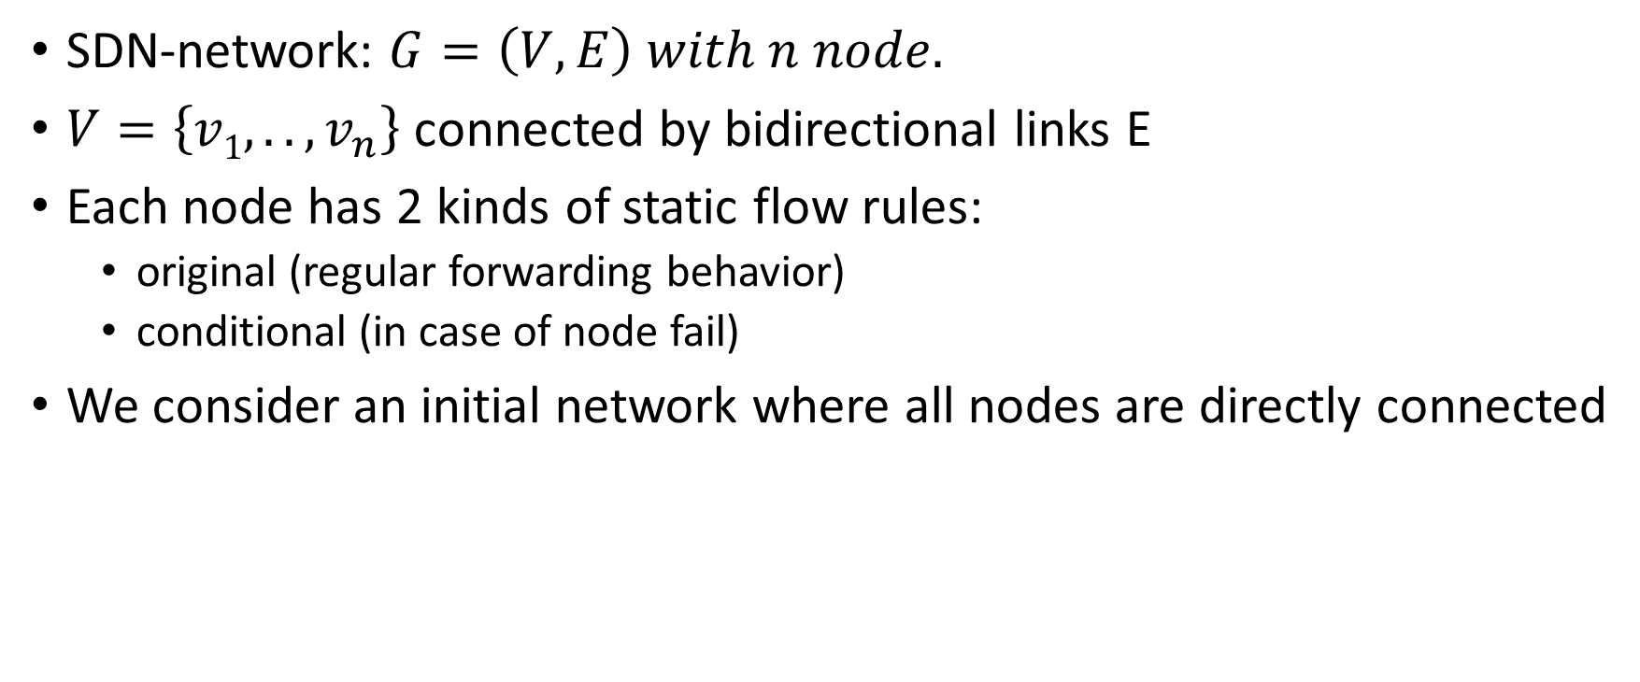
Problem statement model
SDN-network: $G=\left(V, E\right) with n node.$
$V=\left\{v1, .. ,v_{n}\right\}$ connected by bidirectional links E
Each node has 2 kinds of static flow rules:
original (regular forwarding behavior)
conditional (in case of node fail)
We consider an initial network where all nodes are directly connected

Slide 4
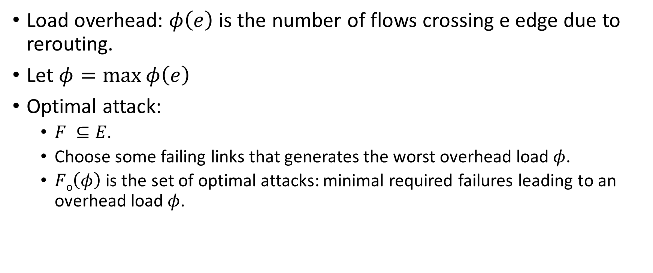
Main definitions
Load overhead: $φ\left(e\right)$ is the number of flows crossing e edge due to rerouting.
Let $φ=\max{φ\left(e\right)}$
Optimal attack:
$F ⊆E.$
Choose some failing links that generates the worst overhead load$φ$.
$F\text{o}\left(φ\right)$ is the set of optimal attacks: minimal required failures leading to an overhead load$φ$.

Slide 5
Failover matrix model
We consider All-to One communication
n flows routed on the network (represented by (s_{i},d_{i}) pairs),
n nodes
S failover scheme represented as M = [m_{i,j}]
i^{th} row means: we want to forward a message from s_{i} to d_{i} (ith flow). If there is not direct link between them we using the ith row to search alternative routes for the d_{i}.

Slide 6

1
6
2
$$\left[1, 2, 3, 4, 5, 6\right]$$
5
3
4

Slide 7

1
6
2
$$\left[1, 2, 3, 4, 5, 6\right]$$
5
3
4

Slide 8

1
6
2
$$\left[1, 2, 3, 4, 5, 6\right]$$
5
3
4

Slide 9

1
6
2
$$\left[1, 2, 3, 4, 5, 6\right]$$
5
3
4

Slide 10
1
6
2
$$\left[1, 2, 3, 4, 5, 6\right]$$
5
3
4

Slide 11
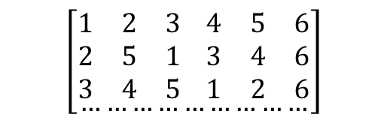
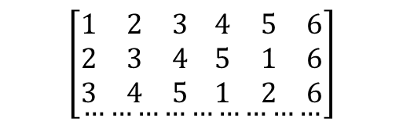
Performance
Let F = {(1,6), (2,6), (3,6)}
$$\left[\begin{aligned}\begin{matrix}1 & 2 & 3 \\ 2 & 3 & 4 \\ 3 & 4 & 5\end{matrix} \begin{matrix}4 & 5 & 6 \\ 5 & 1 & 6 \\ 1 & 2 & 6\end{matrix} \\ ………………………\end{aligned}\right]$$
$$\left[\begin{aligned}\begin{matrix}1 & 2 & 3 \\ 2 & 5 & 1 \\ 3 & 4 & 5\end{matrix} \begin{matrix}4 & 5 & 6 \\ 3 & 4 & 6 \\ 1 & 2 & 6\end{matrix} \\ ………………………\end{aligned}\right]$$
vs
1
1
The resulting overhead load is 3 on (4,6) in the left matrix while it is 2 on the right.
The worse performance comes from the similarity of each node’s scheme.
2
6
2
6
5
3
5
3
4
4

Slide 12
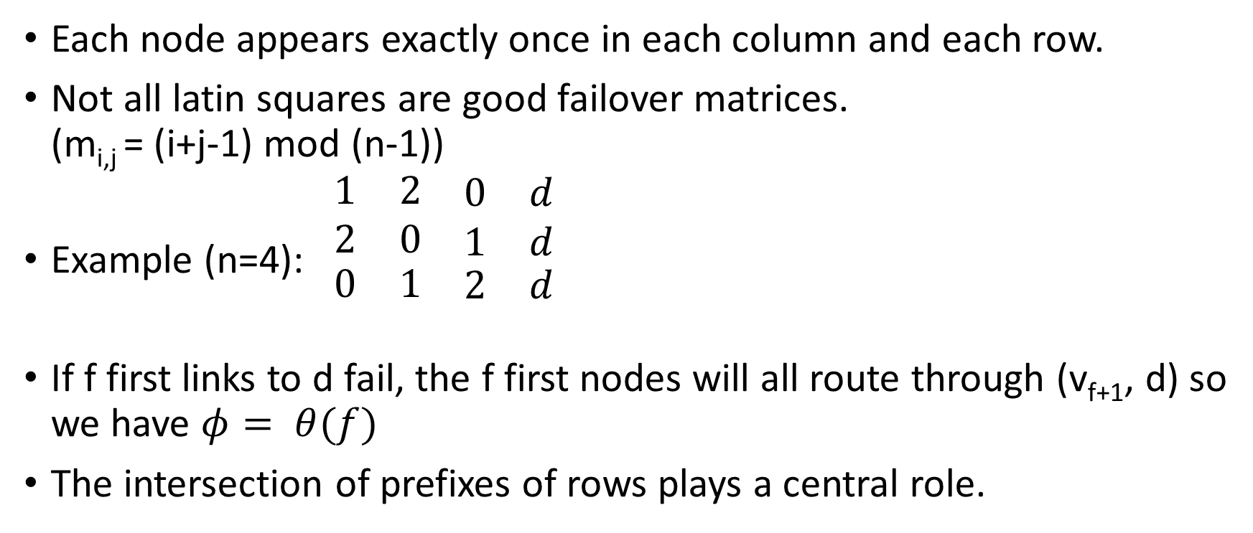
Latin square schemes
Each node appears exactly once in each column and each row.
Not all latin squares are good failover matrices. (m_{i,j} = (i+j-1) mod (n-1))
Example (n=4): $\begin{matrix}1 & 2 & \begin{matrix}0 & d\end{matrix} \\ 2 & 0 & \begin{matrix}1 & d\end{matrix} \\ \begin{matrix}0 \\ \end{matrix} & \begin{matrix}1 \\ \end{matrix} & \begin{matrix}\begin{matrix}2 & d\end{matrix} \\ \end{matrix}\end{matrix}$
If f first links to d fail, the f first nodes will all route through (v_{f+1}, d) so we have $φ= θ(f)$
The intersection of prefixes of rows plays a central role.

Slide 13
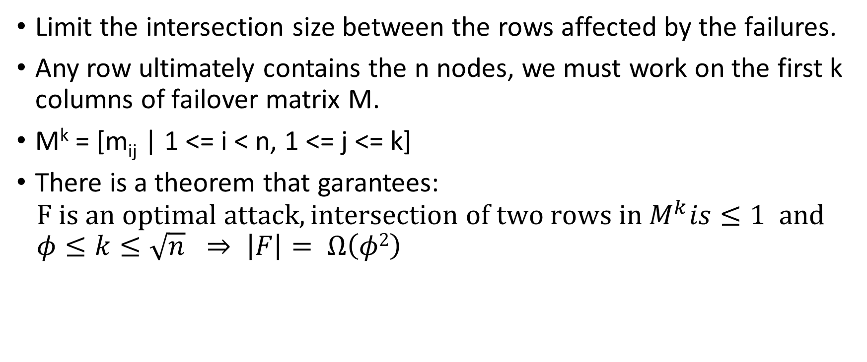
M^{k} matrix
Limit the intersection size between the rows affected by the failures.
Any row ultimately contains the n nodes, we must work on the first k columns of failover matrix M.
M^{k} = [m_{ij} | 1 <= i < n, 1 <= j <= k]
There is a theorem that garantees: $F is an optimal attack, intersection of two rows in M^{k}is≤1 and$ $φ≤k≤\sqrt{n} ⇒ \left|F\right|= Ω\left(φ2\right)$

Slide 14
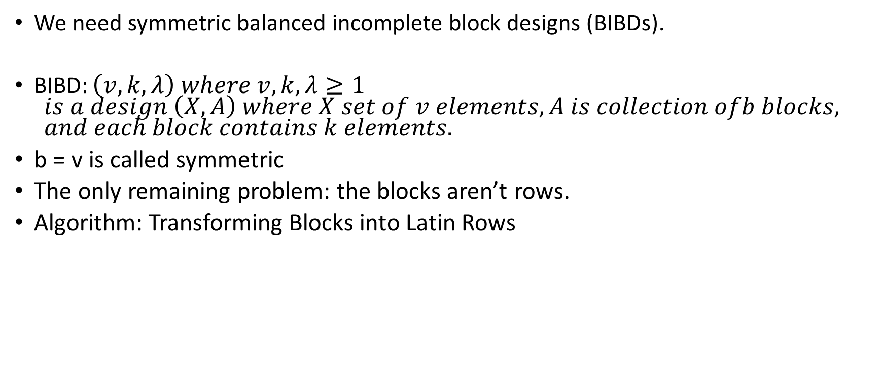
How to create submatrices of low intersection
We need symmetric balanced incomplete block designs (BIBDs).
BIBD: $\left(v, k, λ\right) where v,k, λ≥1$ $is a design \left(X,A\right) where X set of v elements, A is collection ofb blocks,$ $and each block contains k elements.$
b = v is called symmetric
The only remaining problem: the blocks aren’t rows.
Algorithm: Transforming Blocks into Latin Rows

Slide 15

1,4
1
3,4
2
$\begin{matrix}1 \\ 4 \\ \begin{aligned}2 \\ 3\end{aligned}\end{matrix}$
1,2
3
3,2
4

Slide 16

1,4
1
3,4
2
$\begin{matrix}1 \\ 4 \\ \begin{aligned}2 \\ 3\end{aligned}\end{matrix}$ $\begin{matrix}4 \\ 3 \\ \begin{aligned}1 \\ 2\end{aligned}\end{matrix}$
1,2
3
3,2
4

Slide 17
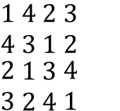
1,4
1
3,4
2
$\begin{matrix}1 \\ 4 \\ \begin{aligned}2 \\ 3\end{aligned}\end{matrix}$ $\begin{matrix}4 \\ 3 \\ \begin{aligned}1 \\ 2\end{aligned}\end{matrix}$ $\begin{matrix}2 \\ 1 \\ \begin{aligned}3 \\ 4\end{aligned}\end{matrix}$ $\begin{matrix}3 \\ 2 \\ \begin{aligned}4 \\ 1\end{aligned}\end{matrix}$
1,2
3
3,2
4
Run algorithm with complementer blocks

Slide 18
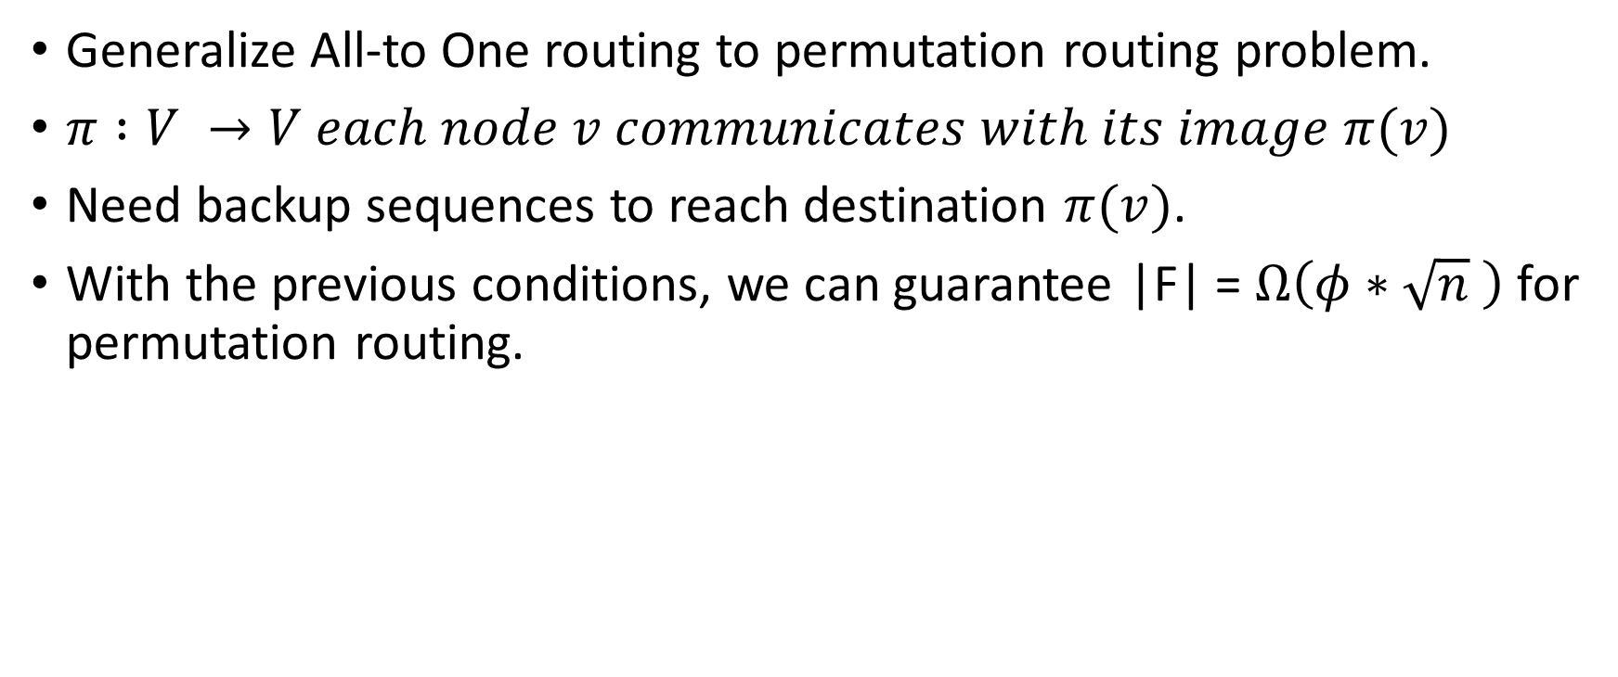
Permutation routing
Generalize All-to One routing to permutation routing problem.
$π :V →V each node v communicates with its image π(v)$
Need backup sequences to reach destination $π(v)$.
With the previous conditions, we can guarantee |F| = $Ω\left(φ∗\sqrt{n} \right)$ for permutation routing.

Slide 19

Arbitrary traffic patterns
$Ω\left(φ2\right)$ link failures are necessary to generate a failover load$φ<\sqrt{n}.$

